Slide 1
Guest Lecture Stanford ME469: Advection Operators
Stefan P. Domino
Computational Thermal and Fluid Mechanics
Sandia National Laboratories SAND2018-4536 PE

Slide 2
Advection Operators: Outline
Classic Analysis on Advection/Diffusion/Time Scalar Transport
The Role of Diagonal Dominance
Upwind Methods
Linear Residual-Based Stabilization
Nonlinear Residual-Based Stabilization
Conclusions

Slide 3
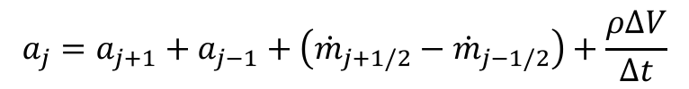
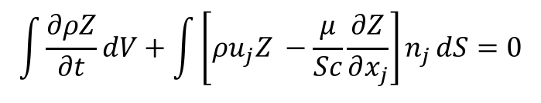
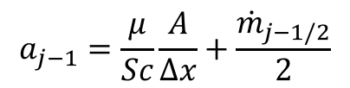
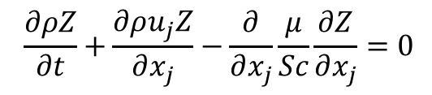
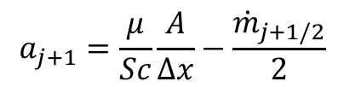
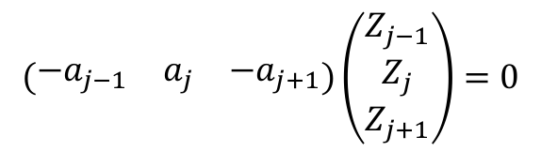
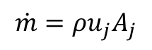
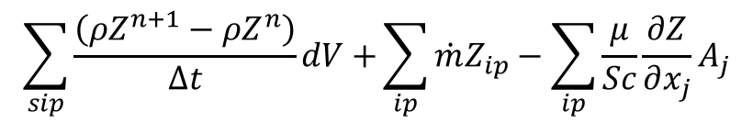
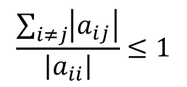
Consider a Simple Advection/Diffusion/Time Scalar Transport
$$\frac{∂ρZ}{∂t}+\frac{∂ρu_{j}Z}{∂x_{j}}−\frac{∂}{∂x_{j}}\frac{μ}{Sc}\frac{∂Z}{∂x_{j}}=0$$
PDE is given by:
Integral form:
Discrete form:
Matrix Form:
$$\int{\frac{∂ρZ}{∂t}dV+\int{\left[ρu_{j}Z −\frac{μ}{Sc}\frac{∂Z}{∂x_{j}}\right]n_{j}}dS=0}$$
$$\sum_{sip}{\frac{\left(ρZ^{n+1}−ρZ^{n}\right)}{Δt}dV+}\sum_{ip}{\dot{m}Z_{ip}−\sum_{ip}{\frac{μ}{Sc}}}\frac{∂Z}{∂x_{j}}A_{j}$$
Mass flow rate:
$$\dot{m}=ρu_{j}A_{j}$$
$$\left(\begin{matrix}−a_{j−1} & a_{j} & −a_{j+1}\end{matrix}\right)\left(\begin{matrix}Z_{j−1} \\ Z_{j} \\ Z_{j+1}\end{matrix}\right)=0$$
$$a_{j+1}=\frac{μ}{Sc}\frac{A}{Δx}−\frac{{\dot{m}}_{j+1/2}}{2}$$
$$a_{j−1}=\frac{μ}{Sc}\frac{A}{Δx}+\frac{{\dot{m}}_{j−1/2}}{2}$$
$$\frac{\sum_{i≠j}{\left|a_{ij}\right|}}{\left|a_{ii}\right|}≤1$$
$$a_{j}=a_{j+1}+a_{j−1}+\left({\dot{m}}_{j+1/2}−{\dot{m}}_{j−1/2}\right)+\frac{ρΔV}{Δt}$$
j-1
j
j+1

Slide 4
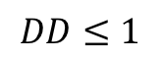
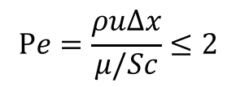
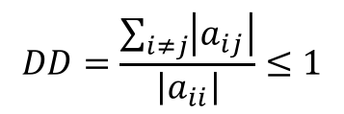
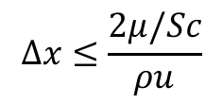
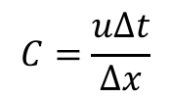
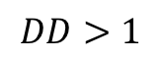
Diagonal Dominance Check
$$DD=\frac{\sum_{i≠j}{\left|a_{ij}\right|}}{\left|a_{ii}\right|}≤1$$
For a monotonic operator:
Consider u = 1 cm/s; ρ = 1.2e-3 g/cm3; μ/Sc = 1.8e-4 g/cm-s; Δx = 0.1 cm; ; Δt >> 1:
a_{j+1}=1.2e-5 a_{j-1}=2.4e-5 a_{j} = 3.6e-5
Stable and monotonic field will be realized; Re = 0.67
Consider u = 10 cm/s; ρ = 1.2e-3 g/cm3; μ/Sc = 1.8e-4 g/cm-s; Δx = 0.1 cm; Δt >> 1:
a_{j+1}=-4.2e-5 a_{j-1}=7.8e-5 a_{j} = 3.605e-5
Unstable and lack of scalar monotonicity will be realized; Re = 6.7
Standard preconditioner, e.g., SGS, are not expected to converge the linear system
Mesh spacing for monotonicity must be:
Cell Peclet number, Pe is a cell-Reynolds number based on local properties and mesh spacing
Consider u = 10 cm/s; ρ = 1.2e-3 g/cm3; μ/Sc = 1.8e-4 g/cm-s; Δx = 0.1 cm; Δt =?
For diagonal dominance, Δt = 0.0143 which corresponds to a Courant number of unity
This can limit the ability for some linear solvers to converge the linear system
$$DD≤1$$
$$DD>1$$
$$Δx≤\frac{2μ/Sc}{ρu}$$
$$Pe=\frac{ρuΔx}{μ/Sc}≤2$$
$$C=\frac{uΔt}{Δx}$$

Slide 5
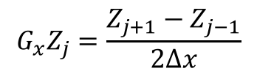
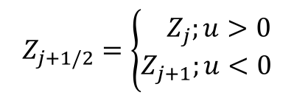
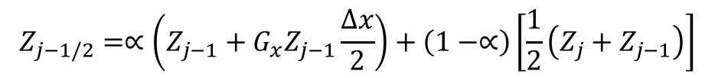
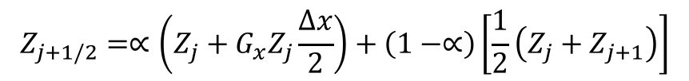
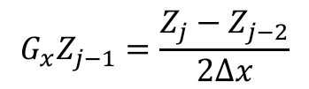
Upwind Operators
Upwind advection operators can provide diagonal dominance (at the cost of accuracy)
However, upwind operators, even if higher-order, are numerically diffuse
Higher-order upwind (second-order in space) can be obtained on an unstructured mesh by use of projected nodal gradients and extrapolation:
j-1
Z_{j-1/2}
j
Z_{j+1/2}
j+1
$$Z_{j+1/2}=\left\{\begin{aligned}{ Z}_{j};u>0 \\ Z_{j+1};u<0\end{aligned}\right.$$
“as the wind blows”
$$G_{x}Z_{j}=\frac{Z_{j+1}−Z_{j−1}}{2∆x}$$
$$G_{x}Z_{j−1}=\frac{Z_{j}−Z_{j−2}}{2∆x}$$
$$Z_{j+1/2}=∝\left(Z_{j}+G_{x}Z_{j}\frac{∆x}{2}\right)+\left(1−∝\right)\left[\frac{1}{2}\left(Z_{j}+Z_{j+1}\right)\right]$$
α is a blending
parameter
for u>0
$$Z_{j−1/2}=∝\left(Z_{j−1}+G_{x}Z_{j−1}\frac{∆x}{2}\right)+\left(1−∝\right)\left[\frac{1}{2}\left(Z_{j}+Z_{j−1}\right)\right]$$

Slide 6
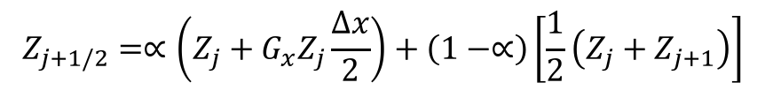
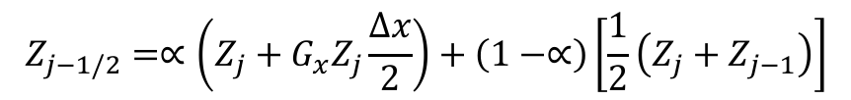
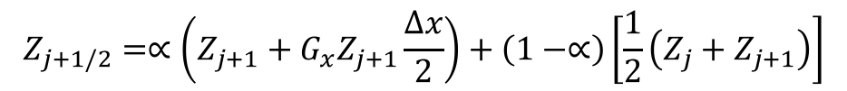
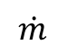
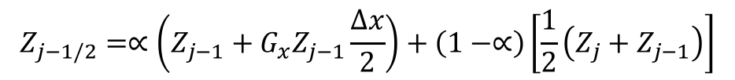
Pseudo Higher-order Upwind
Blending extrapolated upwind with central (Z_{L}+Z_{R})/2 provides:
Slope limiting required when gradients are not smooth (Berger et al, 2005, 43rd AIAA)
$$Z_{j+1/2}=∝\left(Z_{j}+G_{x}Z_{j}\frac{∆x}{2}\right)+\left(1−∝\right)\left[\frac{1}{2}\left(Z_{j}+Z_{j+1}\right)\right]$$
for u>0
$$Z_{j−1/2}=∝\left(Z_{j−1}+G_{x}Z_{j−1}\frac{∆x}{2}\right)+\left(1−∝\right)\left[\frac{1}{2}\left(Z_{j}+Z_{j−1}\right)\right]$$
$$Z_{j+1/2}=∝\left(Z_{j+1}+G_{x}Z_{j+1}\frac{∆x}{2}\right)+\left(1−∝\right)\left[\frac{1}{2}\left(Z_{j}+Z_{j+1}\right)\right]$$
for u<0
$$Z_{j−1/2}=∝\left(Z_{j}+G_{x}Z_{j}\frac{∆x}{2}\right)+\left(1−∝\right)\left[\frac{1}{2}\left(Z_{j}+Z_{j−1}\right)\right]$$
$$\dot{m}$$
j-2 | j-1 | j | j+1 | j+2 | α
1/4 | -5/4 | +3/4 | +1/4 | 0 | 1 | >0
0 | -1/4 | -3/4 | +5/4 | -1/4 | 1 | >0
+1/6 | -6/6 | +3/6 | +2/6 | 0 | 1/2 | <0
0 | -2/6 | -3/6 | +6/6 | -1/6 | 1/2 | <0
Resulting
1-D Stencil

Slide 7
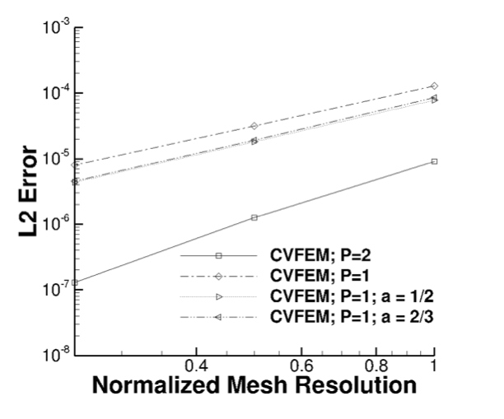
Pseudo Higher-order Upwind
Caveat: In practice, this method provides only a small shift in accuracy
Quadrature error dominated

Slide 8
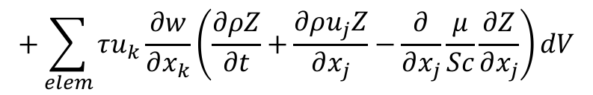
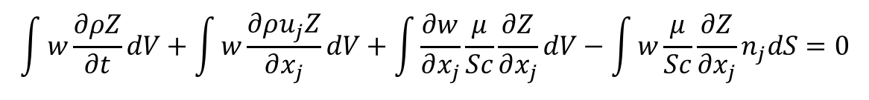
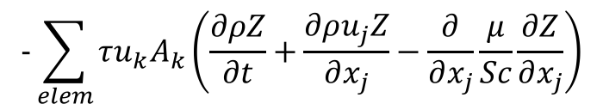
Linear Residual-Based Stabilization
Is there a better way that either un-stabilized (oscillatory and non-monotonic) and dissipative upwind?
Consider the model advection/diffusion PDE in the context of a FEM
Concept: Add a scaled fine-scale residual for stabilization, Streamwise Upwind Petrov Galerkin SUPG (Hughes and Brooks, 1982)
As noted earlier, CVFEM can be recovered by applying the piecewise-constant test function, w:
Godunuv’s theorem states that a linear stabilization approach is not sufficient to damp out all oscillations
$$\int{w\frac{∂ρZ}{∂t}dV+\int{w\frac{∂ρu_{j}Z}{∂x_{j}}}dV+\int{\frac{∂w}{∂x_{j}}}\frac{μ}{Sc}\frac{∂Z}{∂x_{j}}dV−\int{w}\frac{μ}{Sc}\frac{∂Z}{∂x_{j}}n_{j}dS=0}$$
$$+\sum_{elem}{τu_{k}\frac{∂w}{∂x_{k}}\left(\frac{∂ρZ}{∂t}+\frac{∂ρu_{j}Z}{∂x_{j}}−\frac{∂}{∂x_{j}}\frac{μ}{Sc}\frac{∂Z}{∂x_{j}}\right)}dV$$
$$−\sum_{elem}{τu_{k}A_{k}\left(\frac{∂ρZ}{∂t}+\frac{∂ρu_{j}Z}{∂x_{j}}−\frac{∂}{∂x_{j}}\frac{μ}{Sc}\frac{∂Z}{∂x_{j}}\right)}$$

Slide 9
Linear Residual-Based Stabilization for CVFEM
Is there a better way that either un-stabilized (oscillatory and non-monotonic) and dissipative upwind?
Consider the model advection/diffusion PDE in the context of a FEM
Concept: Add a scaled fine-scale residual for stabilization, Streamwise Upwind Petrov Galerkin (Hughes and Brooks, 1982)
As noted earlier, CVFEM can be recovered by applying the piecewise-constant test function, w:
Godunuv’s theorem states that a linear stabilization approach is not sufficient to damp out all oscillations
$$\int{w\frac{∂ρZ}{∂t}dV+\int{w\frac{∂ρu_{j}Z}{∂x_{j}}}dV+\int{\frac{∂w}{∂x_{j}}}\frac{μ}{Sc}\frac{∂Z}{∂x_{j}}dV−\int{w}\frac{μ}{Sc}\frac{∂Z}{∂x_{j}}n_{j}dS=0}$$
$$+\sum_{elem}{τu_{k}\frac{∂w}{∂x_{k}}\left(\frac{∂ρZ}{∂t}+\frac{∂ρu_{j}Z}{∂x_{j}}−\frac{∂}{∂x_{j}}\frac{μ}{Sc}\frac{∂Z}{∂x_{j}}\right)}dV$$
$$−\sum_{elem}{τu_{k}A_{k}\left(\frac{∂ρZ}{∂t}+\frac{∂ρu_{j}Z}{∂x_{j}}−\frac{∂}{∂x_{j}}\frac{μ}{Sc}\frac{∂Z}{∂x_{j}}\right)}$$

Slide 10
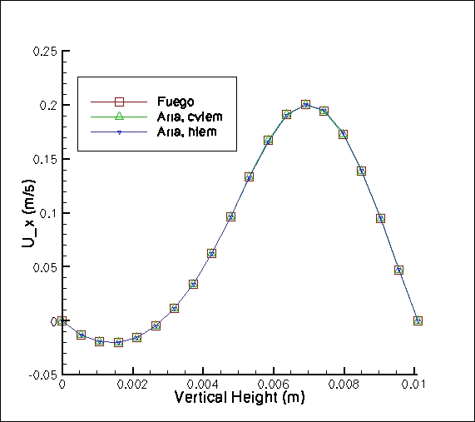
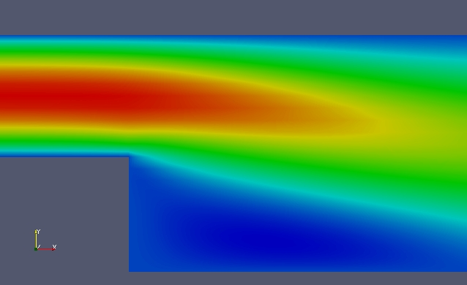
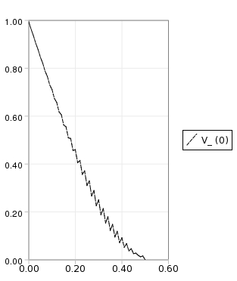
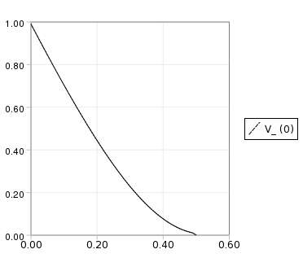
SUPG in Practice (CVFEM and FEM)
SUPG and analog in CVFEM, Streamwise Upwind Control Volume (SUCV) are effective for low-moderate cell-Peclet numbers
Un-stabilized and SUPG
SUPG/SUCV backstep velocity prediction

Slide 11
Nonlinear Stabilization Approach
Consider a general transport equation for φ
An artificial viscosity approach is provided with coefficient again related to a fine-scale residual:
Piecewise-constant test function for CVFEM (with fourth order-form)
Similar concept to Guermond’s “Entropy-viscosity” approach, 2013
Can also form an interesting LES model when the viscosity is a function of the k.e. fine scale residual (Guermond and Larios, 2015)
,
,
FEM-based DCO (Shakib, 91)
Co-variant and contra-variant metric tensors
or min…..
Coefficient based on local residual
Limit the coefficient based on an upwind analogy

Slide 12
Advection Operators: Conclusion
Without diagonal dominance, lack of monotonicity is noted
Upwind approaches can help, however, comes at the price of numerical accuracy
Residual-based approaches, which stem from the FEM literature, are useful candidates for CVFEM

